Slide 1
Parallel Computing
Ekkapot Charoenwanit
Software Systems Engineering
TGGS
KMUTNB

Slide 2
Lecture 9:
Shared-Memory Programming with OpenMP
Memory Models
OpenMP Memory Model

Slide 3
Memory Models
Memory models define the allowed behavior of a shared memory system in terms of the order in which memory reads and memory writes may appear to execute.
The memory model specifies, for a given multithreaded program, what values a read can return.
There can be more than one possible outcomes allowed by the given memory model.
The memory model serves as an interface between the programmer and the system so it
affects programmability because programmers must use it to reason about the correct of their programs
affects performance because it determines the types of optimizations that may be exploited by the hardware and the system software
affects portability when moving software across different systems that support different memory models

Slide 4
Memory Models
A memory model needs to be specified for every level at which there is an interface between the programmer and the system:
At the ISA interface, the memory model affects the designer of the computer architecture and the programmer who writes or reasons about machine code that runs on the hardware
At the high-level language interface, the memory model affects both the designer of the compiler software and the programmer who writes or reasons about code written in high-level languages.
Therefore, the memory model has a significant impact on
the writing of multithreaded programs from the programmer’s perspective and
virtually all aspects of designing a parallel system(including processor, memory system, interconnection network, compiler and programming languages).

Slide 5
Memory Models
Reasoning about multithreaded execution can be mind-boggling.
Assume that x = 0 and y = 0, initially.
One would expect that only the following three final states (r1,r2) are possible: (0,0), (0,1) and (1,1)
Q: What is wrong with (r1,r2)=(1,0)?
A: We would probably think this final state wouldn’t be reached because our intuition is based on the Sequential Consistency model.
Thread T0 Thread T1
x = 1 r1 = y
y = 1 r2 = x

Slide 6



Sequential Consistency Model
The most intuitive memory consistency model is the Sequential Consistency (SC) model.
SC was first formalized by Lamport in [1]:
“A multiprocessor system is sequentially consistent if the result of any execution is the same as if the operations of all the processors were executed in some sequential order, and the operations of each individua processor appear in this sequence in the order specified by its program.”
The behavior of SC should be the same as if there were a single global switch that multiplexes among memory operations from the processors.
$$P_{0}$$
$$P_{1}$$
$$P_{n−1}$$
Shared Memory

Slide 7
Sequential Consistency Model
There are two key aspects to Sequential Consistency:
Maintaining program order among operations from individual threads
Maintaining a single sequential order among operations from all threads
referred to as write atomicity makes it appear as if each memory operation executes atomically or instantaneously with respect to other memory operations.

Slide 8
Sequential Consistency Model
Sufficient Conditions for SC
Program Order: memory ordering has to follow the order in each individual thread
Threads issue memory operations in program order.
Before issuing the next memory operations, threads wait until their last issued memory operations complete.
Write Atomicity: a store by a thread is logically seen by all other threads at once
A read is allowed to complete only if the matching write (i.e., the one whose value is returned by the read) also completes(i.e., until the write becomes visible to all threads).
In a SC system, the operations of a program appear to take place in some total order, and that total order is consistent with the order of operations on each individual thread.
SC is too strong.
The two conditions are easily violated by modern hardware and compilers.

Slide 9
Sequential Consistency Model
Let us return to the previous example, where x = y = 0, initially.
Suppose that r1=1 and r2 = 0.
r1=1 implies (2) happens-before (3):
r2=0 implies (4) happens-before (1):
Thread T0 Thread T1
(1) x = 1 (3) r1 = y
(2) y = 1 (4) r2 = x
Thread T0 Thread T1
(1) x = 1 (3) r1 = y
(2) y = 1 (4) r2 = x

Slide 10
Sequential Consistency Model
Thread T0 Thread T1
(1) x = 1 (3) r1=y
(2) y = 1 (4) r2 = x
By the Program Order condition,
(1) happens-before (2)
(3) happens-before (4)
We can see that the happens-before relationship is cyclic.
This final state cannot be reached in SC.

Slide 11
Sequential Consistency Model
The rules of SC we just discussed are intuitive to the programmer.
The idea is that multiple threads executing in parallel are accessing a single shared main memory.
SC implementations will result in poor performance.
SC is a strong memory model.
The benefits of multiple threads, instruction-level parallelism, etc. are greatly limited ☹

Slide 12
Weak Memory Model
Dekker’s Algorithm
Assume that Flag1 = Flag2 = 0, initially.
Q: Can the two threads be inside the critical section simultaneously?
A: It depends.
If Dekker’s Algorithm runs on an SC machine, no.
Otherwise, yes, on a machine with a weaker memory model.
Thread T0 Thread T1
(1) Flag1 = 1 (3) Flag2 = 1
(2) if(Flag2==0) (4) if(Flag1==0)
Critical Section Critical Section

Slide 13
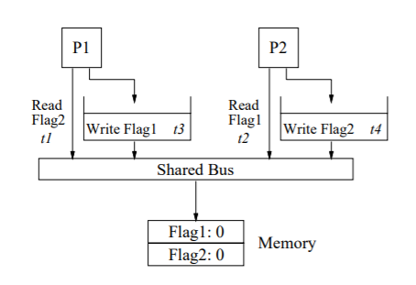
Weak Memory Model: Write Buffer
On most real hardware, what causes Dekker’s Algorithm to break is the existence of write buffers.
Figure Credit: [2]

Slide 14
Weak Memory Model: Write Buffer
Purposes of the write buffer
If the core issues writes that occur at a faster rate than the cache can respond, the write buffer can absorb the pending writes while the core can proceed to execute other instructions without stalling.
If there are multiple writes to different words that reside on the same cachline, these writes can be combined into a single write, which can reduce the number of writes that need to be serviced by the cache.

Slide 15
Weak Memory Model: Write Buffer
On a write, a processor simply inserts the write operation into the write buffer and proceeds without waiting for the write to complete.
Subsequent reads are allowed to bypass any previous writes in the write buffer for faster completion.
This bypassing mechanism is allowed as long as the read address does not match any of the pending writes in the write buffer.
In the case of Dekker’s Algorithm, both reads can be serviced by the memory system before either write is serviced, thereby allowing both reads to return 0.

Slide 16
OpenMP: Memory Model
Temporary view and Memory
The OpenMP memory model consists of two components:
The global memory shared by all threads (processors)
The temporary view of the memory associated with the individual threads
Temporary View of Memory
Temporary View of Memory
Temporary View of Memory
Thread
Thread
Thread
Interconnect
Shared Memory

Slide 17
OpenMP: Memory Model
Temporary View of Memory
Temporary View of Memory
Temporary View of Memory
Read and write operations of a thread refer to the temporary view.
The temporary view may or may not be consistent with the shared memory.
Consistency can only be achieved by a flush operation.
A flush ensures that whatever a thread has written to its own temporary view will be visible in the shared memory.
Whatever a different thread has flushed to the shared memory will be available for reading in the thread’s temporary view.
Thread
Thread
Thread
Interconnect
Shared Memory

Slide 18
OpenMP: Memory Model
OpenMP supports a relaxed memory model.
Each thread can maintain a temporary view of shared memory that is not consistent with that of other threads.
These temporary views are made consistent with the shared memory at certain points in the program.
The operation used to maintain consistency is the flush operation.

Slide 19
OpenMP: Flush
Each thread has a temporary view of shared memory that it uses to store data temporarily and hidden from the other threads.
Writes to memory can be delayed and overlapped with other operations.
Reads from memory may be directly satisfied with local copies (cached in CPU registers) until they are forced into memory by flushes.
The flush operation defines a sequence of points at which a thread is guaranteed to see a consistent view of the shared memory.
Upon a flush, a thread performs the following:
Force all the pending writes into the shared memory
Discard the local copies and satisfy reads directly from the shared memory
Prevent any reads or writes from this thread from reordering across the flush
This is analogous to a fence in other shared memory APIs/ISAs.

Slide 20
OpenMP: Flush
Compilers can reorder instructions that implement a program.
Modern compilers are highly aggressive in that they generate code to exploit the functional units, keep the CPU busy, hide memory latencies etc.
The compiler generates code that maintains only the as-if-serial semantics.
When it comes to code for multithreaded programs, things can break.
Compilers generally cannot move instructions past:
a barrier
a flush on all variables
The flush operation does not synchronize different threads
It just ensures that a thread’s variables (temporary view) are main consistent with the shared memory.

Slide 21
OpenMP: Flush
In OpenMP, a flush is implicit in the following synchronization locations:
At entry to and exit from parallel regions
At implicit and explicit barriers
At entry to and exit from critical regions
At exit from work-sharing constructs unless nowait is present
Immediately before and after TSPs
During the following runtime functions: omp_set_lock() and omp_unset_lock()
At entry to and exit from the atomic construct
Warning
Avoid using explicit flushes !!!
it is difficult to get it working .
Even an expert often get it wrong.
You may need explicit flushes if you want to implement your own spinlocks.

Slide 22

OpenMP: Flush
The flush directive can take a flush-set specified with a list of variables a flush is to performed on.
A flush without a flush-set is equivalent to one with a flush-set specified with all visible variables.

Slide 23
OpenMP: Flush
The compiler is not allowed to reorder reads or writes of the variables in the flush-set around a flush.
All previous reads and writes of the flush-set by this thread have completed.
No subsequent reads or writes of the flush-set by this thread have occurred.
All variables in the flush set are moved from temporary storage, i.e., registers, to the shared memory.
Reads of variables in the flush-set that follow that flush are loaded from the shared memory.
Again, keep in mind that the flush operation only makes the calling thread’s temporary view consistent with the shared memory.
The flush operation by itself does not synchronize itself with other threads.

Slide 24
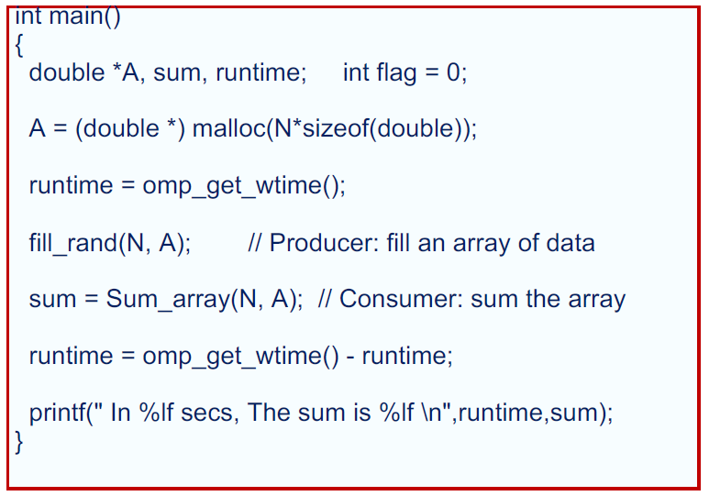
OpenMP: Flush
Producer-Consumer Problem
TO DO:
Implement pairwise synchronization
between the producer and the consumer
thread
Figure Credit: [3]

Slide 25
OpenMP: Flush
OpenMP lacks pairwise constructs that work between pairs of threads.
In Pthreads, we have condition variables that can be used to synchronize between a pair of threads.
When needed, we have to implement it ourselves !!!
Pairwise Synchronization can be implemented as follows:
Use a shared flag variable
Have the consumer spin waiting for the new value of the shared flag
Use flushes to force updates to and from memory

Slide 26
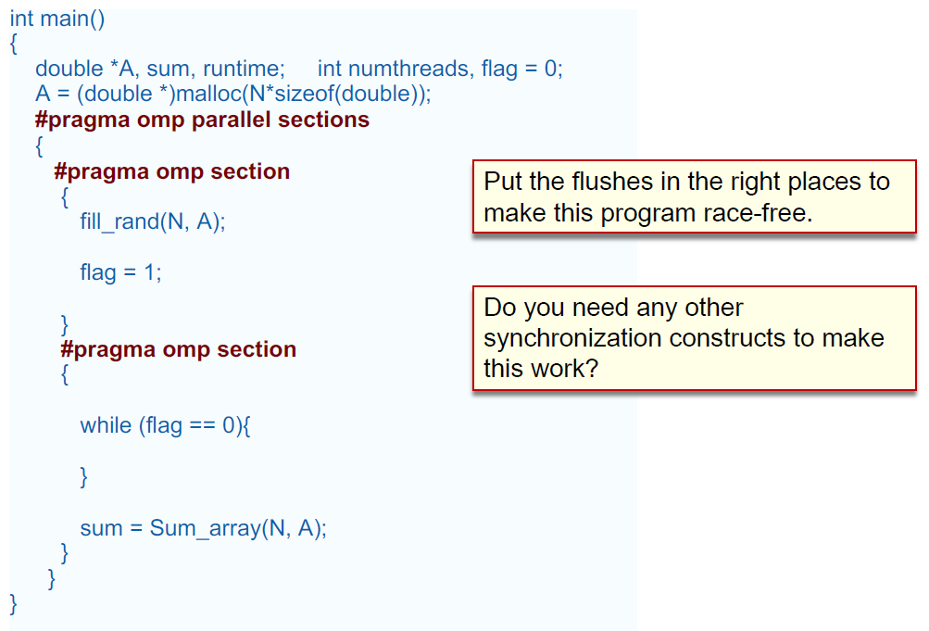
OpenMP: Flush
Figure Credit: [3]

Slide 27
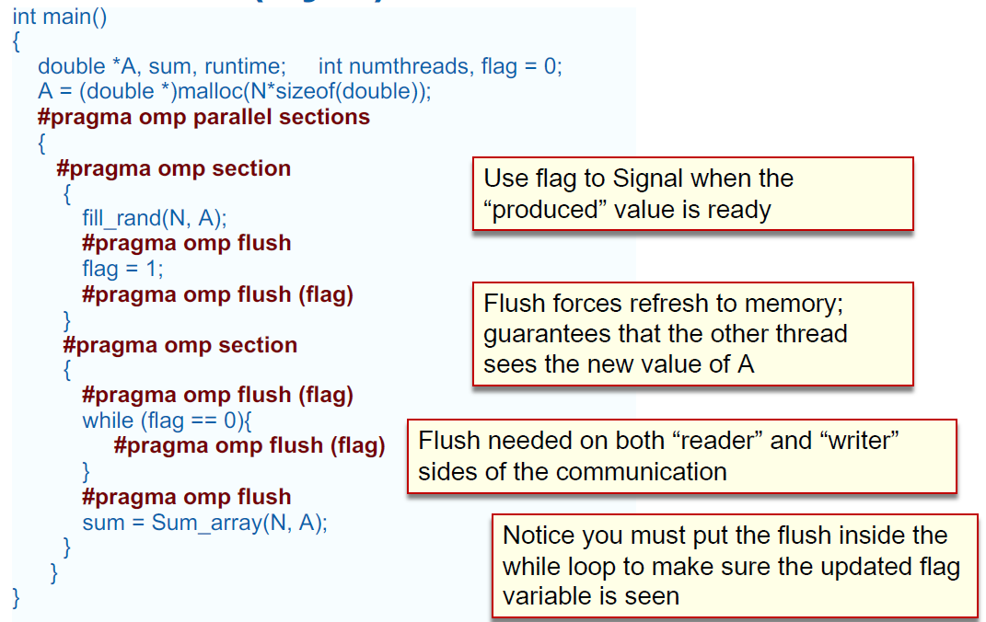
OpenMP: Flush
Is this code correct?
Figure Credit: [3]

Slide 28
OpenMP: Flush
This code is not data-race free, but it works correctly on x86 machines.
Figure Credit: [3]

Slide 29
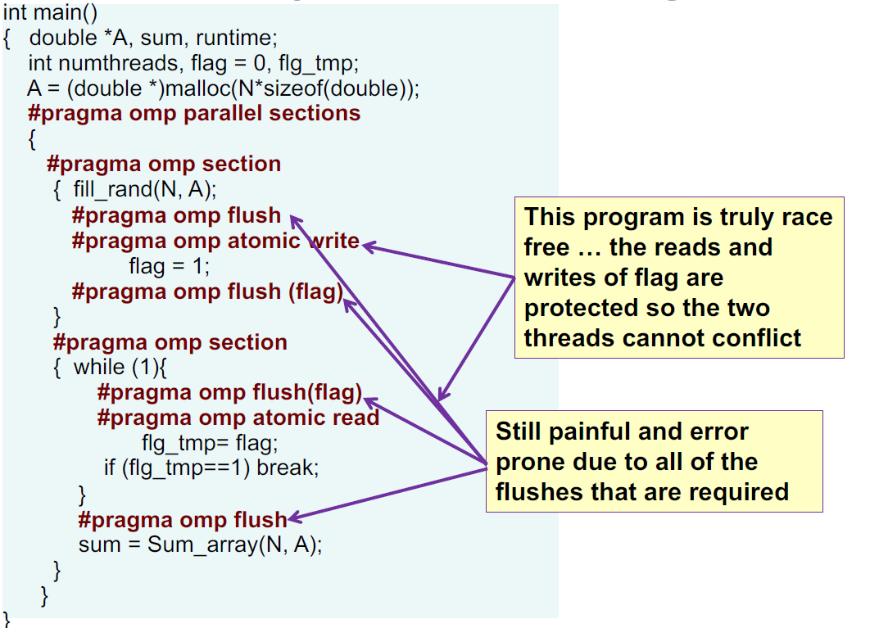
OpenMP: Flush
The problem with the code on the last slide is that the reads ands write of the shared flag variable are necessarily atomic operations.
If not protected, a data race can occur.
Figure Credit: [3]

Slide 30
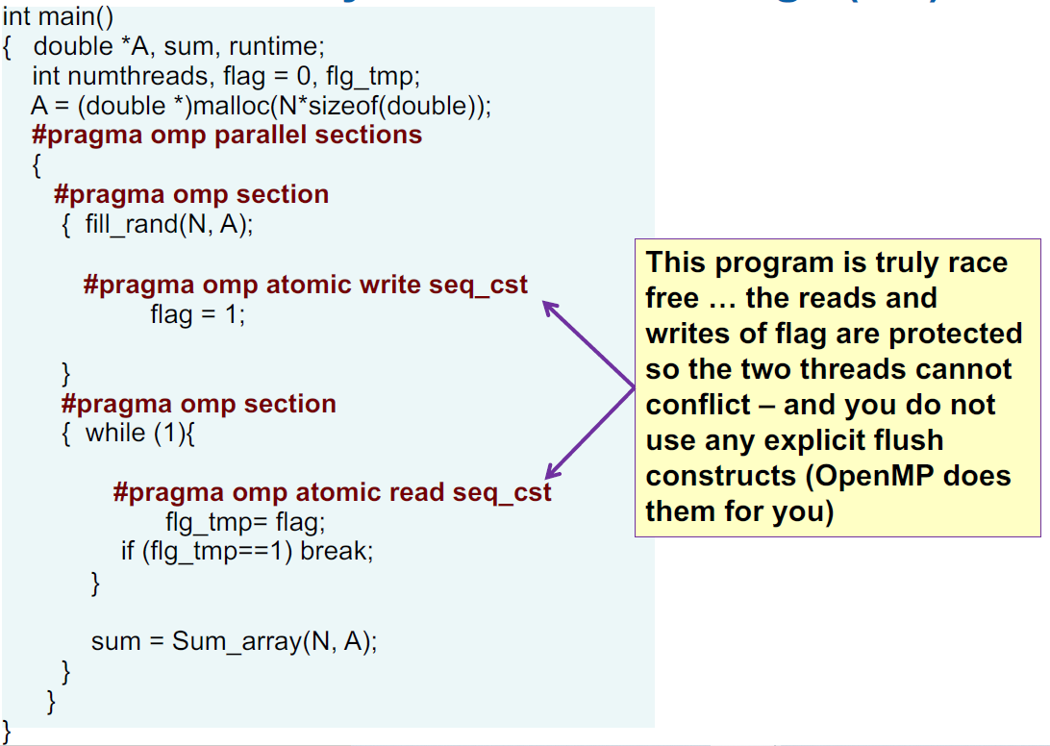
OpenMP: Flush
OpenMP 4.0 added an optional clause seq_cst to the atomic directive to impose sequential consistency on reads and writes operations of the associated atomic variable.
If the seq_cst clause is included, OpenMP implicitly adds a flush without a flush-set to the atomic operation.
Figure Credit: [3]

Slide 31
References
[1] L. Lamport. 1979. How to Make a Multiprocessor Computer That Correctly Executes Multiprocess Programs. IEEE Trans. Comput. 28, 9 (September 1979), 690–691. DOI:https://doi.org/10.1109/TC.1979.1675439
[2] Sarita V. Adve and Kourosh Gharachorloo. 1996. Shared Memory Consistency Models: A Tutorial. Computer 29, 12 (December 1996), 66–76. DOI:https://doi.org/10.1109/2.546611
[3] Tim Mattson. 2020. A Hands-on Introduction to OpenMP.

